Slide 1
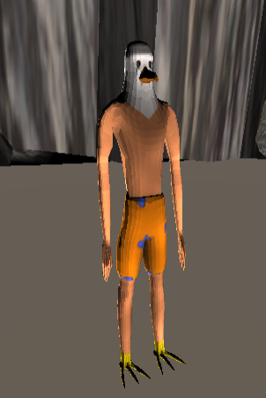
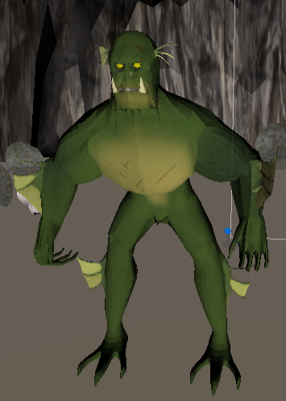
Tutorial
Gillface is chasing you! To get away from him you need to run 1000 meters in the docks and then defeat him in his own cave. If he grabs you before you can run the 1000 meters, this will cost a life (you have 3 lives total). He will take you to his closest cave and try to eat you there. Damage him enough in this cave to go back to the docks and continue running for the 1000 meters.
Good luck Gullface!
Gullface
Gillface
You can pause the game at any time by pressing ‘P’ on your keyboard.

Slide 2
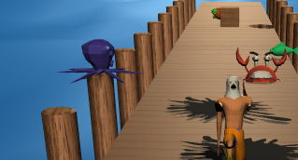
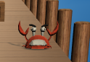
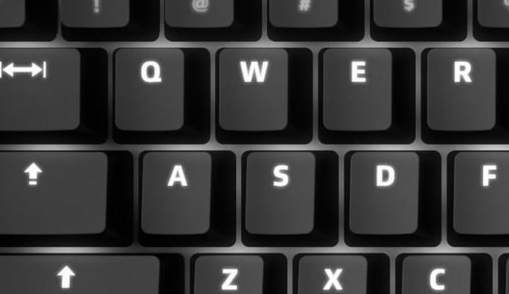
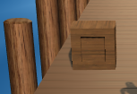
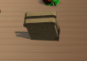
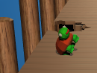
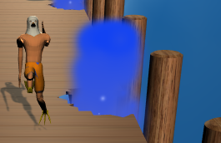
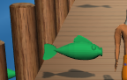
Docks tutorial
You will run automatically. There are just 3 buttons to press in the docks:
a – for moving left
d – for moving right
spacebar – for jumping
Goal: run 1000 meters
Octopus
The octopus will help you by shooting his ink on the track, making you slip and go faster.
And here is everything you will encounter in the docks
Crab
The crab will move side to side and try to slow you down by blocking your way.
Bread
You can pick up this piece of bread by walking over it. It will give you a speed-boost, unless it’s old and rotten, then it will slow you down. Unfortunately there’s no way to tell which is which.
Wooden crate
The wooden crate is a passive object that will block your way.
Turtle
When you walk over this turtle, your legs will be much slower for a second.
Fish
The fish will jump over the docks. If you hit one, you will be slowed down.
Water fountain
The water fountain will launch you up in the air, but is not always active.

Slide 3
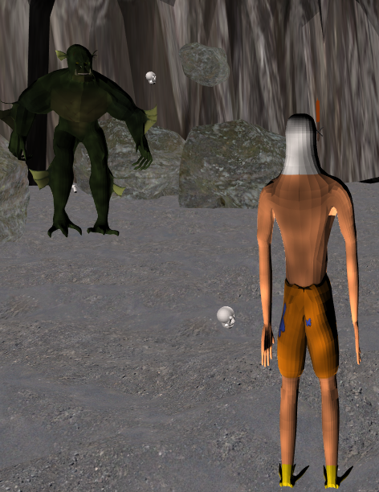
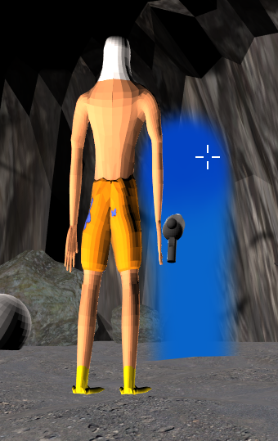
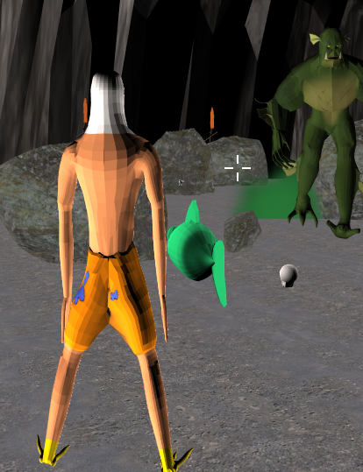
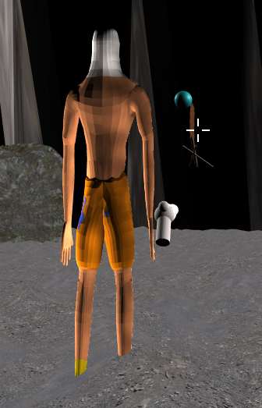
Cave tutorial
Goal: kill Gillface before he kills you
There are 3 weapons you can pick up and shooting by left-clicking the mouse. Use the numbers 1, 2 and 3 to switch between weapons.
You can move around with w, a, s, d.
You can jump with the spacebar.
Move the camera and your crosshair with the mouse.
Gillface will try to kill you by throwing skulls of his past victims and large rocks at you
Water blaster
Fish cannon
Ice cannon

